Slide 1
Unit - 6
Firewall Design Principals
Trusted Systems
Intrusion Detection Systems
1

Slide 2
Firewalls
Effective means of protecting a local system or n/w of systems from n/w-based security threats
Also afford access to the outside world via WANs and the Internet
Overview of Firewalls
Firewall Design Principles
Internet access provides benefits to the user (organization) , it enables the outside world to reach and interact with local network assets. This creates a threat to the organization
Threats can be defeated by using firewall
Location: The firewall is inserted between the premises network and the Internet
Purpose: To protect the premises network from Internet-based attacks and to provide a single choke point where security can be imposed
The firewall may be a single computer system or a set of two or more systems that cooperate to perform the firewall function
Firewall Design Principles | Characteristics
Capabilities | Limitations

Slide 3
Firewall Characteristics
1.All traffic from inside to outside, and vice versa, must pass through the firewall
2.Only authorized traffic, as defined by the local security policy, will be allowed to pass. Various types of firewalls are used, which implement various types of security policies
3.The firewall itself is immune to penetration(this implies the use of Trusted system with a secure OS)
The following are the four general techniques taht firewalls use to control access and enforce security policy.
Service control: Determine the types of Internet services that can be accessed, inbound or outbound(filters based on IP address and TCP port no)
Direction Control:Determines the direction in which particular service requests may be initiated and allowed to flow through the firewall.
User control: Controls access to a service according to which user is attempting to access it.
Behavior Control:Controls how particular services are used.For example, the firewall may filter e-mail to eliminate spam.

Slide 4
Capabilities of the firewall
1.A firewall defines a single choke point that
keeps unauthorized users out of the protected network,
prohobits vulnerable services from entering or leaving the network, and
provides protection from various kinds of IP spoofing and routing attacks
2.A firewall provides a location for monitoring security-related events
3.A firewall is convenient platform for several Internet functions that are not security related (e.g., network address translator and network management function)
4.A firewall can serve as the platform for IPSec
Limitations of the firewall
1.The firewall cannot protect against attacks that bypass the firewall.
2.The firewall does not protect against internal threats
3.The firewall cannot protect against the transfer of virus-infected programs or files

Slide 5
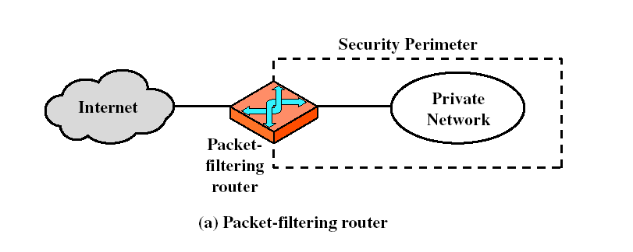
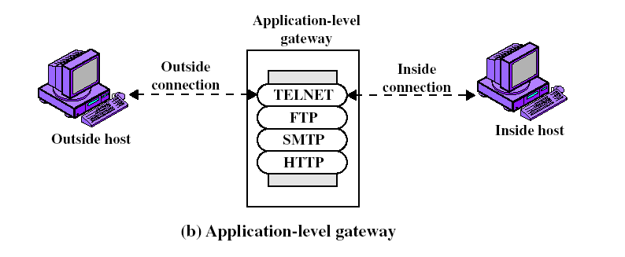
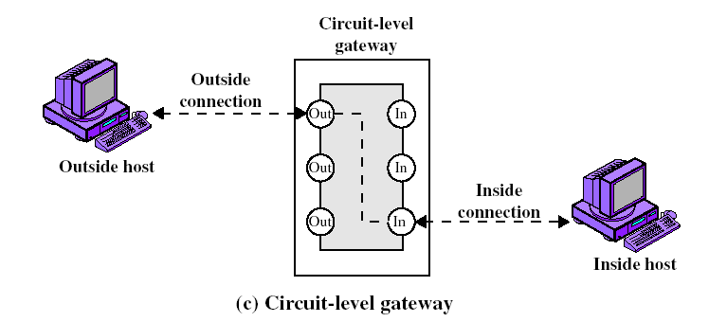
Types of Firewalls

Slide 6
1.Packet-Filtering Router
What is it? It applies a set of rules to each incoming IP packet or outgoing IP packet and then forwards or discards the packet
Filtering rules based on fields in
      IP and transport (e.g., TCP or UDP) header, including source and destination IP address,
      IP protocol field, and
      TCP or UDP port number
Advantages : simplicity.
      transparent to users and are very fast
Disadvantages :difficulty of setting up packet filter rules correctly
        the lack of authentication

Slide 7
2.Application-Level Gateway
Also called a proxy server, acts as a relay of application-level traffic
The user contacts the gateway using a TCP/IP application, such as Telnet or FTP, and the gateway asks the user for the name of the remote host to be accessed
When the user responds and provides a valid user ID and authentication information, the gateway contacts the application on the remote host and relays TCP segments containing the application data between the end points
Application-level gateways tend to be more secure than packet filters

Slide 8
3.Circuit-Level Gateway
This can be a stand-alone system or it can be a specialized function performed by an application-level gateway for certain functions
It does not permit an end-to-end TCP connection; rather, the gateway sets up two TCP connections,
    between itself and a TCP user on an inner host and
    between itself and TCP user on an outside host
Once the two connections are established, the gateway typically relays TCP segments from one connection to the other without examining the contents
Typical Use: A system where system administrator trusts the internal users
2
1

Slide 9
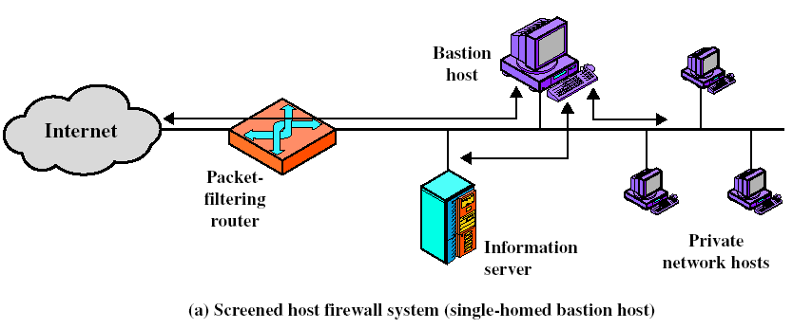
Bastion Host
A bastion host is a system identified by the firewall administrator as a critical strong point in the network’s security
Bastion host serves as a platform for an application-level or circuit-level gateway
Firewall Configurations

Slide 10
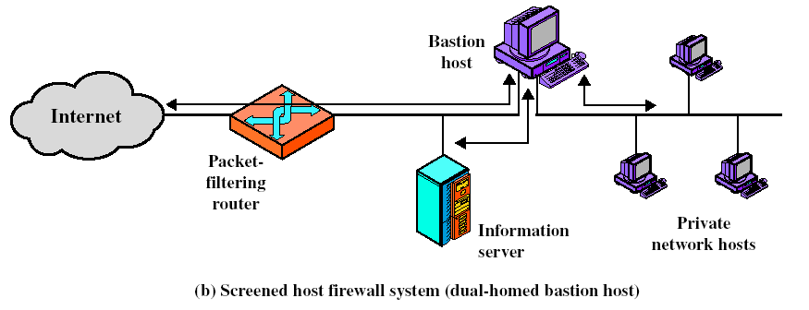
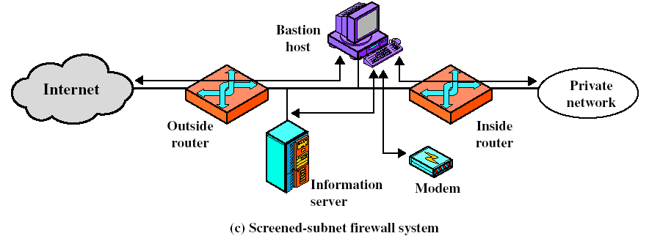

Slide 11
In the screened host firewall, single-homed bastion configuration, the firewall consists of two systems: a packet-filtering router and a bastion host
The router is configured so that
  1.For traffic from the Internet, only IP packets destined for the bastion host are allowed in
  2.For traffic from the internal network, only IP packets from the bastion host are allowed out
The bastion host performs authentication and proxy functions
This configuration has greater security than simply a packet-filtering router or an application-level gateway alone
Here, if the packet-filtering router is completely compromised, traffic could flow directly through the router between the Internet and other hosts on the private network

Slide 12
Screened host firewall, dual-homed bastion configuration physically prevents such a security breach
Advantages of dual layers of security of the previous configuration are present here too
The screened subnet firewall configuration is the most secure
In this, 2 packet-filtering routers are used, 1-between BH and Internet & 2 - between BH and Internal n/w
Again, an information server or other hosts can be allowed direct communication with the router
This creates an isolated subnetwork, which may consist of simply the BH but may also include 1/more information servers and modems for dial-in capability
Both the Internet and the internal network have access to hosts on the screened subnet, but traffic across the screened subnet is blocked

Slide 13
Trusted Systems
One way to enhance the ability of a system to defend against intruders and malicious programs is to implement trusted system technology
Data Access Control
Following successful logon, the user has been granted access to one or a set of hosts and applications
This is generally not sufficient for a system that includes sensitive data in its database
Through the user access control procedure, a user can be identified to the sysytem’
Associated with each user, there can be a profile that specifies permissible operations and file accesses
The operating system can then enforce rules based on the user profile
The database management system, however, must control access to specific records or even portions of records
A general model of access control as exercised by a file or database management system is that of an access matrix (Fig 10.3a)

Slide 14
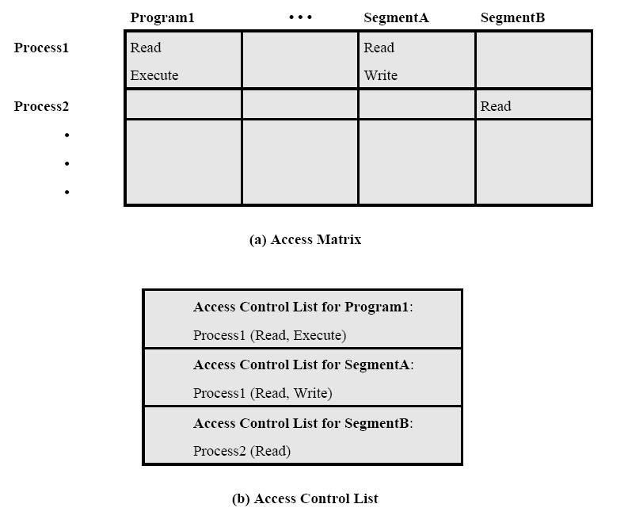
The basic elements of the model are as follows:
-Subject: An entity capable of accessing objects. Any user or application actually gains access to an object by means of a process that represents that user or application

Slide 15
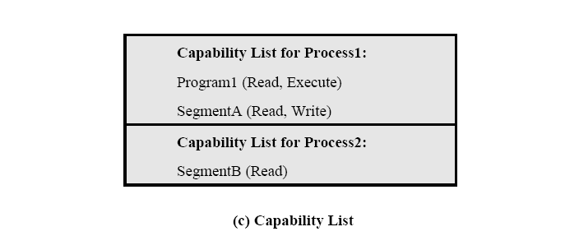
-Object: Anything to which access is controlled. Examples include files, programs, and segments of memory
-Access right: The way in which an object is accessed by a subject. Examples are read, write, and execute
One axis of the matrix consists of identified subjects that may attempt data access other axis of the matrix consists of objects that may be accessed
Each entry in the matrix indicates the access rights of that subject for that object
In practice, an access matrix is usually sparse and is implemented by decomposition in one of two ways

Slide 16
The matrix may be decomposed by columns, yielding access control lists (Fig 10.3b). Thus, for each object, an access control list lists users and their permitted access rights
Decomposition by rows yields capability tickets (Fig 10.3c). A capability list specifies authorized objects and operations for a user
The Concept of Trusted Systems
Last section deals with protecting a given message or item from passive or active attack by a given user
Another requirement is to protect data or resources
on the basis of levels of security
This is commonly found in the military, where information is categorized as unclassified (U), confidential (C), secret (S), top secret (TS), or beyond
This concept is equally applicable in other areas
For example corporate planning documents and data, accessible by only corporate officers and their staff; next might come sensitive financial and personnel data, accessible only by administration personnel, corporate officers
When multiple categories or levels of data are defined, the requirement is referred to as multilevel security

Slide 17
A multilevel secure system must enforce the following:
-No read up: A subject can only read an object of less or equal security level. This is referred to in the literature as the Simple Security Property
-No write down: A subject can only write into an object of greater or equal security level. This is referred to in the literature as the *-Property
For a data processing system, the approach is based on the reference monitor concept
This approach is depicted in Fig 10.4
The reference monitor is a controlling element in the hardware and operating system of a computer that regulates the access of subjects to objects on the basis of security parameters of the subject and object
The reference monitor has access to a file, known as the security kernel database, that lists the access privileges (security clearance) of each subject and the protection attributes (classification level) of each object
The reference monitor enforces the security rules (no read up, no write down) and has the following properties:

Slide 18
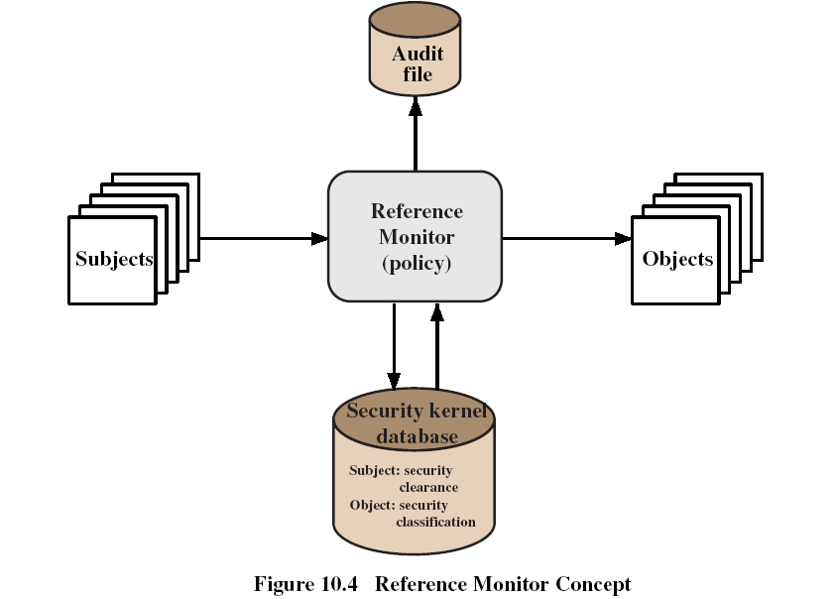
-Complete mediation: The security rules are enforced on every access, not just, for example, when a file is opened
-Isolation: The reference monitor and database are protected from unauthorized modification
-Verifiability: The reference monitor’s correctness must be provable.
A system that can provide such verification is referred as a trusted system
A final element in Fig 10.4 is an audit file. Important security events, such as detected security violations and authorized changes to the security kernel database, are stored in the audit file

Slide 19
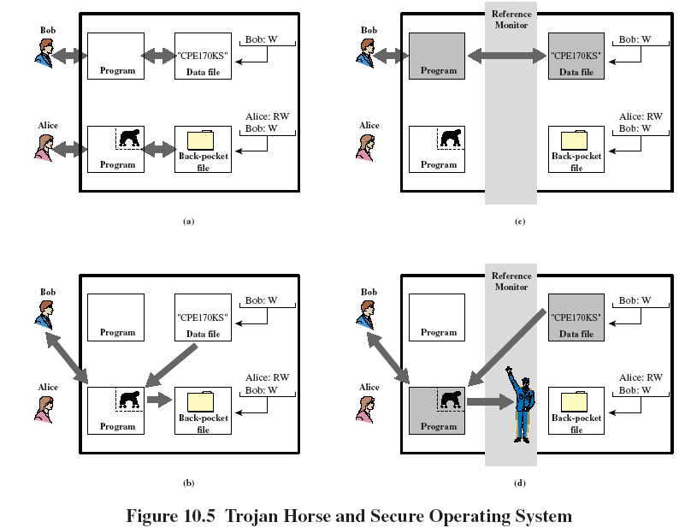
Trojan Horse Defense
One way to secure against Trojan horse attacks is use of a secure, trusted operating system

Slide 20
Fig 10.5 illustrates an example
In this example, a user named Bob interacts through a program with a data file containing the critically sensitive character string “CPE170KS”
User Bob has created the file with read/write permission provided only to programs executing on his own behalf: that is, only processes that are owned by Bob may access the file
The Trojan horse attack begins when a hostile user, named Alice, gains legitimate access to the system and installs both a Trojan horse program and a private file to be used in the attack as a “back pocket”
Alice gives read/write permission to herself for this file and gives Bob write-only permission (Fig 10.5a)
Alice now induces Bob to invoke the Trojan horse program, by advertising it as a useful utility

Slide 21
When the program detects that it is being executed by Bob, it reads the sensitive character string from Bob’s file and copies it into Alice’s back-pocket file (Fig 10.5b)
Now consider the use of a secure operating system in this scenario (Fig 10.5c)
Security levels are assigned to subjects at logon time
In this example, there are two security levels, sensitive and public, ordered so that sensitive is higher than public
Processes owned by Bob and Bob’s data file are assigned the security level sensitive
Alice’s file and processes are restricted to public
If Bob invokes the Trojan horse program (Fig10.5d), that program acquires Bob’s security level. When the program attempts to store the string in a public file (the back-pocket file), however, the *-property is violated and the attempt is disallowed by the reference monitor

Slide 22
Intrusion Detection Systems
If an intrusion is detected quickly enough, the intruder can be identified and ejected from the system before any damage is done or any data are compromised
An effective intrusion detection system can serve as a deterrent, so acting to prevent intrusions
Intrusion detection enables the collection of information about intrusion techniques that can be used to strengthen the intrusion prevention facility
Intrusion detection approaches are:
1.Statistical anomaly detection
2.Rule-based detection
Audit Records: A fundamental tool for intrusion detection is the audit record. Some record of ongoing activity must be maintained by users as input to an intrusion detection system.
Basically two plans are used:
  Native audit records
  Detection-specific audit records

Slide 23
-Native audit records: Virtually all multiuser operating systems include accounting software that collects information on user activity.
-Detection-specific audit records: A collection facility can be implemented that generates audit records containing only that information required by the intrusion detection system
Statistical anomaly detection
Involves the collection of data relating to the behavior of legitimate users over a period of time. Then statistical tests are applied to observed behavior to determine with a high level of confidence whether that behavior is not legitimate user behavior
It has two categories:
-Threshold detection: This approach involves defining thresholds, independent of user, for the frequency of occurrence of various events
-Profile based: A profile of the activity of each user is developed and used to detect changes in the behavior of individual accounts

Slide 24
Rule-based detection
Involves an attempt to define a set of rules that can be used to decide that a given behavior is that of an intruder
It has two categories:
-Anomaly detection: Rules are developed to detect deviation from previous usage patterns
-Penetration identification: An expert system approach that searches for suspicious behavior

